Slide 1

Reopening Hospitality Businesses
Safely and Successfully
Peter Ducker FIH
Chief Executive
Institute of Hospitality

Slide 2


Slide 3
Who saw this one coming?

Slide 4
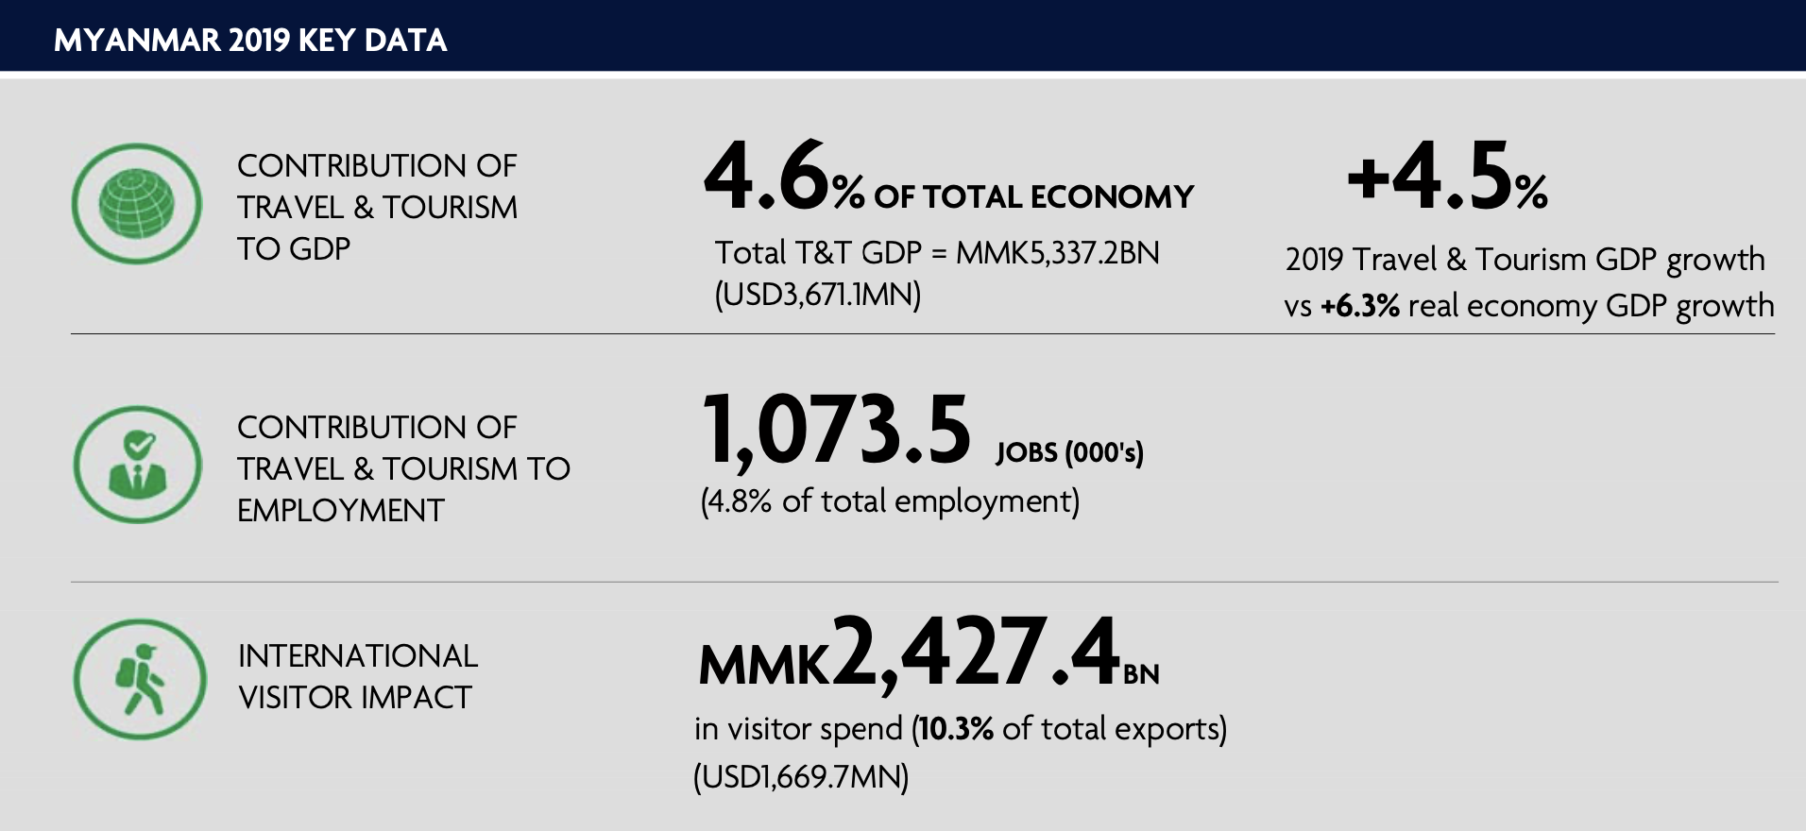
Source WTTC 2019 Data
Notes:
Remember what an important element of the economy your Industry is.
Hospitality Tends to punch below our weight. Need to be aware of this and not lose sight of how important it is to any economy. Tax Take, employment, multiplier effrct supply chain jobs

Slide 5
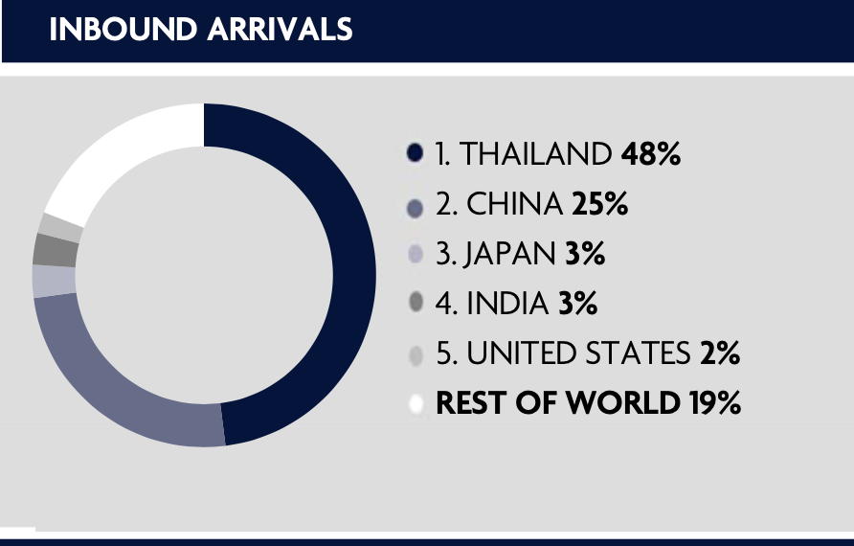
Source WTTC 2019 Data
Notes:
Good news is your demand is largely regional rather than long haul
Currently only rthe domestic market is working but come Sewptember hopefully it will begin to open. Target your marketing at the key yielding markets. You will all know from hyor guest profiling which markets are active when during the year.
Mining your data to target effectiovely has never been more important

Slide 6
Inbound Air reservation trends
Notes:
Inbound to Myanmar, January to June
Green is reservations, Blue is cancellations and Yellow is net business
Teetering along at 2.5K/week, at peak in January it was 26k per week

Slide 7
Where is it coming from?
Notes:
This is information from Amadeus Gicves a slightly different oprofile
Singapoire Thailand and China account for 70%

Slide 8
The new normal
Notes:
Guests will not return if they are not confident. Your hygiene regime is now a part of your key marketing message. Be up front about it on your website and in all your comms.
One lesson that has been learned in countries as thety reopen is that confidence in the safety of a stay is vital. Nobody will visit your property even for a coffee if they do not feel safe.
You have a duty of care to your staff.
Staff team Bubbles
Staff in Masks are a visible sign – Perspex shield masks enable a smile of welcome
Think about how you will rearrange your services –
should you reduce housekeeping mid stay to an on request basis to eliminate staff entering guest rooms.
How will you disinfect between stays – misting spraying or ultra vikolet are all options what can you arrange
Train people to follow protocols closely

Slide 10
Turn the volume down!
Notes:
Think profit – focus on selling what is most profitable,
Sweat your assets – consider widening operational hours inn restaurants
Maintain price levels - but avoid price gouging as return customers are still important, so continue to reward loyalty
Be selective with discounting – only use to add value and to carefully selected target markets where it motivates purchase.
Rethink rate fences – have flexible cancellations, potentially reduce usage of advance purchase rates
Kneejerk reaction is to discount. Rebuilding rates will be a challenge

Slide 11
Think short term
Don’t look too far ahead – the situation is fast changing
Be realistic not optimistic – your understanding of demand and patterns will increase rapidly
Health check your data – look at key data daily – work out what is working and what is not
Notes:
Monitor your reservations closely – what patterns emerge
Typically domestic and regional leisure travel will happen first

Slide 12
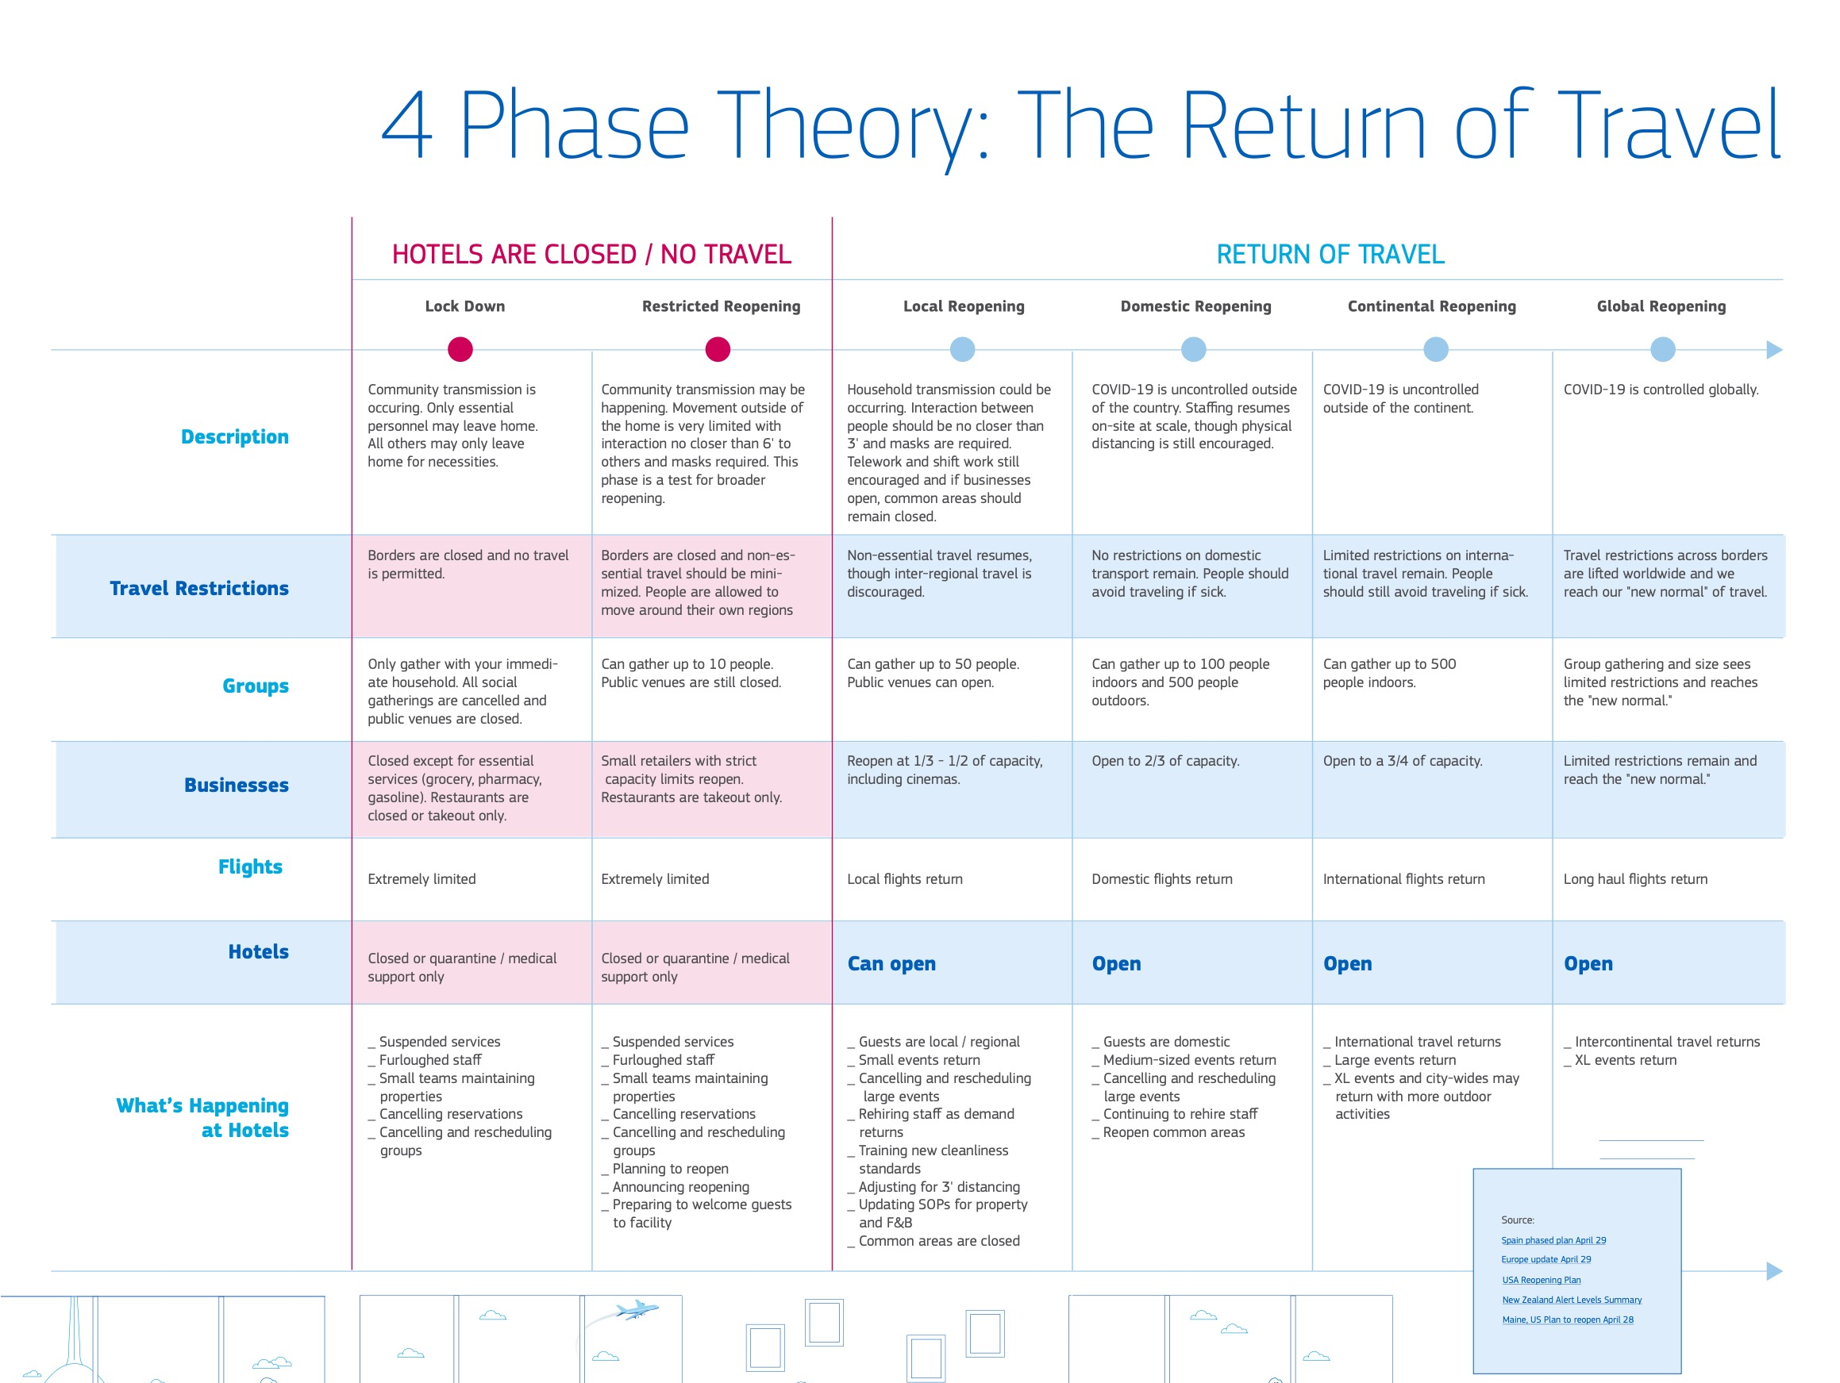
Notes:
Monitor what is happening in airlines – follow the markets that are opening up and target your clients and channels into those markets

Slide 13
peter.ducker@instituteofhospitality.org

