Slide 1

Saving Energy and Costs:
Taking action in Myanmar’s Food and Beverage sector
UK-ASEAN Low Carbon Energy Programme

Slide 2

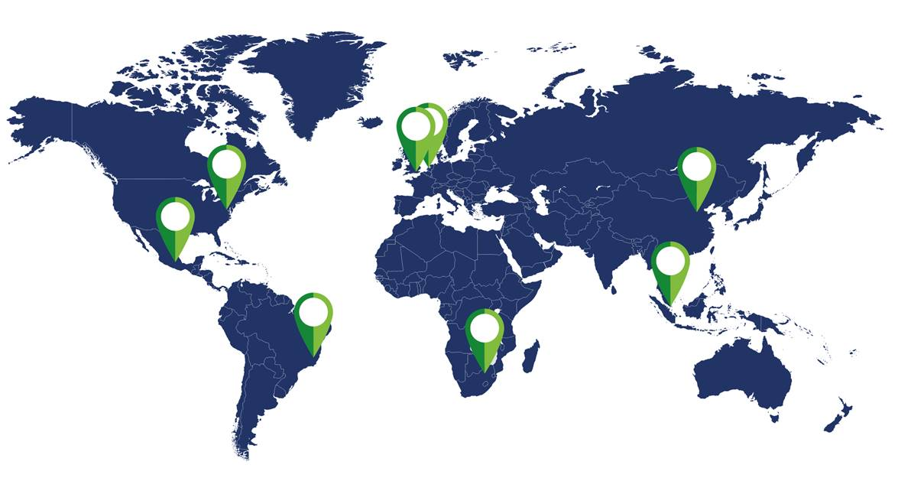
Our mission is to accelerate the move to a sustainable, low carbon economy
We work with governments, multilateral organisations, businesses and the public sector, helping them contribute to and benefit from a more sustainable future
We cut through uncertainty to provide insights that support better decisions
We design and manage projects that overcome financial and behavioural barriers
We recognise clients through assurance and certification of positive outcomes
19
years of global experience
30+
nationalities
in our team
5
working across five continents

Slide 3






ASEAN Low Carbon Energy Programme
The ASEAN Low Carbon Energy Programme (LCEP) is a part of the UK Government’s Prosperity Fund, managed by the UK’s Foreign and Commonwealth Office (FCO), and delivered by a consortium comprising of Ernst & Young, Carbon Trust and IMC Worldwide. The LCEP will address constraints in the energy sector that impede South East Asia’s inclusive economic growth, unlocking increased prosperity for the region.
The LCEP focuses on two topics – Green Finance and Energy Efficiency, and the Carbon Trust leads in the delivery of the energy efficiency component in five countries: Malaysia, Myanmar, Thailand, the Philippines and Vietnam.
2 key pillars
4 areas of support
5 partner countries
Green Finance
Policy Support
Capacity Building
Malaysia
Myanmar
Energy Efficiency
Technical Assistance
Market Development
Philippines
Thailand
Vietnam

Slide 4
Our work in the F&B sector
This Webinar is part of the:
Funded by:
As part of LCEP, we will deliver technical support to companies in the Food & Beverage (F&B) sector in Malaysia, Myanmar, Philippines, Thailand and Vietnam to establish and maintain an Energy Management System (EnMS), with a focus on improving energy efficiency and setting more ambitious energy performance targets.

Slide 5
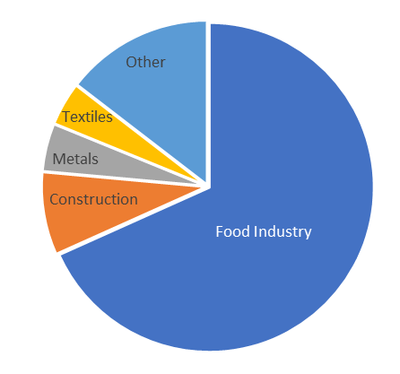
Setting the Context:
Myanmar’s F&B Sector
According to the Tha Bar Wa programme by WWF, there are approximately 27,000 F&B companies, and it is estimated that 90% of these companies are SMEs.
The sub-sectors with the largest number of companies include edible oil, confectionery and agricultural products.
Across large F&B companies, edible oil, confectionery, alcohol and beverages, and milk and milk products are the most common.
According to UNESCAP, the F&B sector represent ~60% of all companies in the industry sector in Myanmar. However, the industry sector itself is quite small, accounting for 6% of Myanmar’s energy consumption.
Source: UNESCAP

Slide 6
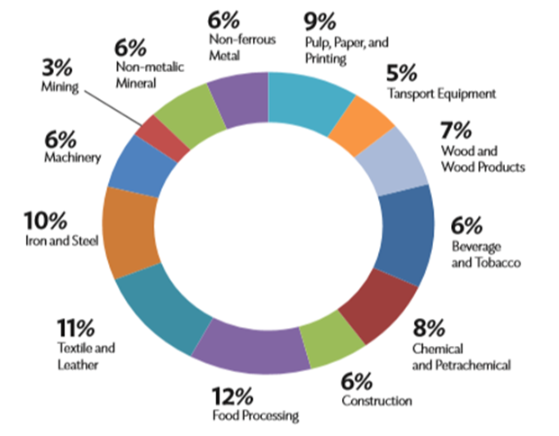
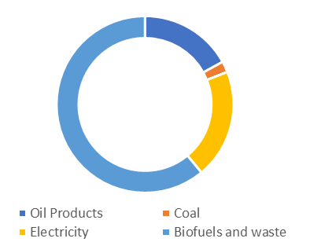
Setting the Context:
Energy Consumption in Myanmar
Energy Consumption by Industrial Sub-Sectors
Energy consumption by Fuel Type in Myanmar’s F&B Sector
Based on the findings from a study by ERIA, it was found that the biggest consumers of energy are the food processing, textile and leather, and the iron and steel industry
110 ktoe of energy was consumed in 2017, which contributed to 152 ktCO2 of GHG emissions and represents 0.48% of the country’s total emissions.
Source: ERIA and International Energy Agency

Slide 7
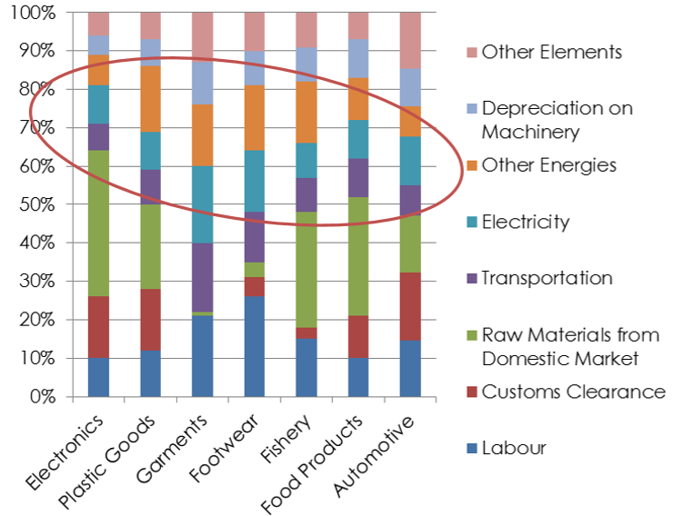
Setting the Context:
Energy Costs in Myanmar
Energy Consumption by Industrial Sub-Sectors in Myanmar (2018)
It is evident that energy costs from fuel and electricity contribute significantly to the operational costs of SMEs across all industrial sub-sectors.
For food products, it is evident that ~20% of total costs are to cover energy bills. ~10% of total costs are from electricity, while another~10% of total costs are from other types of energy use.
The fishery sector sees an even larger proportion of total costs resulting from energy use.
Poll
Source: Myanmar Energy Demand Forecast: Households and Industry, ADB & Japan Fund for Poverty Reduction

Slide 8
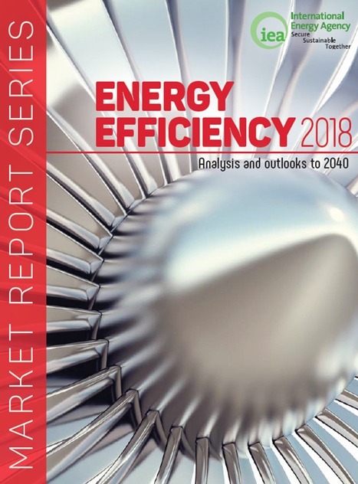
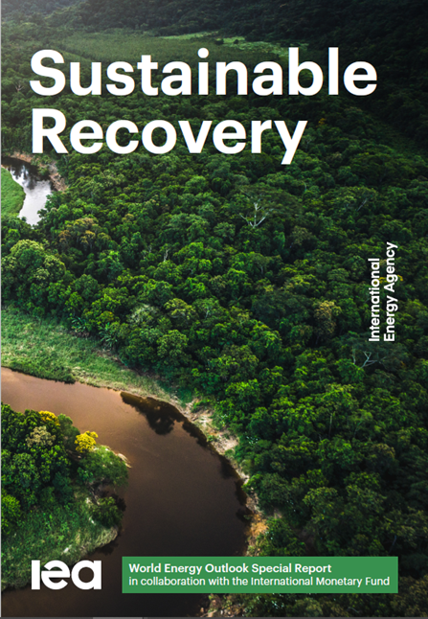
Why save energy?
Increased international focus on energy efficiency [1/2]
“Efficiency can enable economic growth, reduce emissions and improve energy security. The right efficiency policies could enable the world to achieve more than 40% of the emissions cuts needed to reach its climate goals without new technology.”
Energy efficiency measures deliver the largest overall reductions in emissions…and together with PV create the most jobs per million dollars of investment…A review of energy policies show that efficiency measures have not attracted as much attention as they deserve.

Slide 9
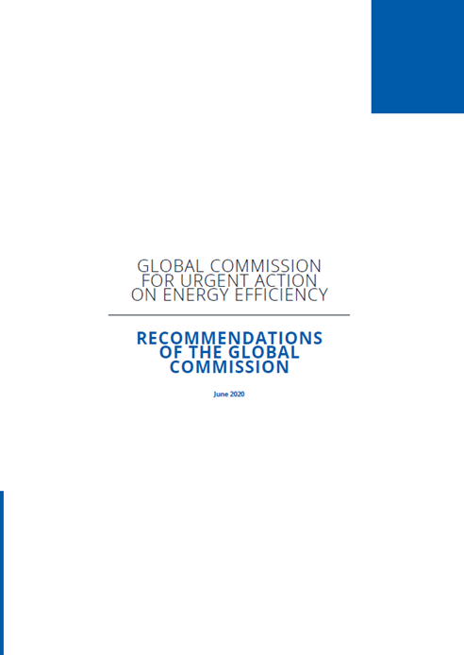
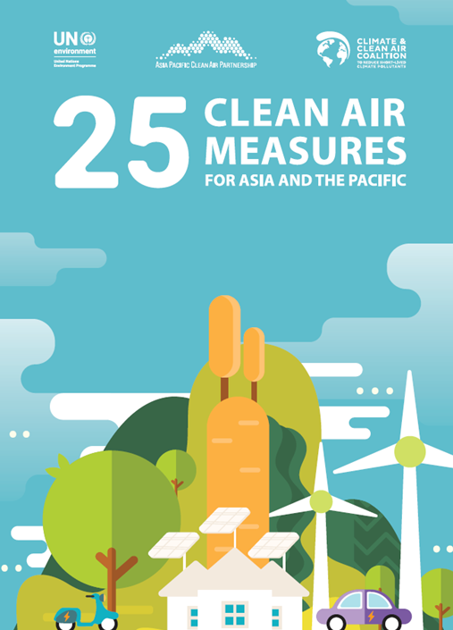
Why save energy?
Increased international focus on energy efficiency [2/2]
“Despite energy efficiency's tremendous potential, the world is struggling to capture its full benefits. Global energy efficiency is not improving quickly enough to offset strong energy demand and CO₂ emissions growth...
efficiency efforts need to be stepped up. ”
“92% of Asia Pacific’s population are exposed to levels of air pollution that pose a significant risk to their health. Air pollution is not only a major health risk, it also has damaging impacts on the environment and agricultural crop yields. These impacts have significant economic consequences.”

Slide 10



Why save energy?
Benefits to companies
Increases
Profit
Good for
Reputation
Improve Employee Engagement
The F&B industry is very energy intensive. By implementing energy savings measures, businesses can cut energy costs, increase profit margins, and improve competitiveness
It is important for businesses to demonstrate their commitment to reducing carbon emissions to ensure that they retain consumer confidence and maintain their market position
Saving energy and reducing environmental impact is good for morale as teams can work together to make positive contributions to improving their environment

Slide 11
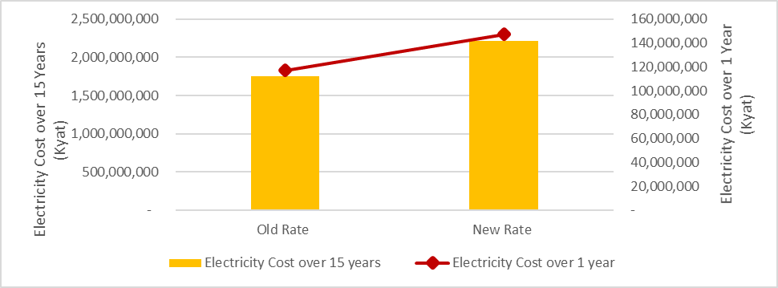
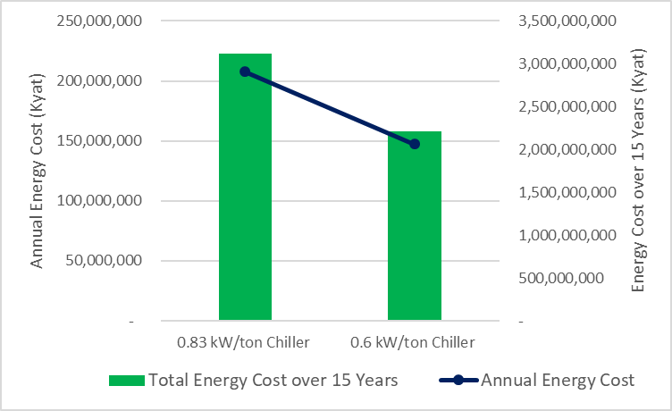
Why save energy?
Impact of the Electricity Tariff on F&B Companies
CASE STUDY Replacing Inefficient Equipment
  A seafood processing factory in Myanmar is affected by the recent hike in electricity prices. As refrigeration is a significant contribution to the factory’s energy use, the facility explores replacing the older, obsolete chillers with energy efficient models.
  Assuming a chiller runs for 15 years, its upfront capital cost is likely to be ~5% of its total cost of ownership (assuming 250 hrs/month
  of operating time at a capacity of 500 tons).
Impact of Electricity Tariff on the Cost of Electricity from running 0.83 kW/ton Chillers
Operating Costs of Chillers by Efficiency (Kyat)
As a result of the new electricity tariff, the cost of running a 0.83 kW/ton Chiller for one year will increase by ~ 39 million kyat. Over the lifetime of the chiller, the total electricity costs will rise by ~588 million kyat compared to running the chiller at the old electricity rate.
The burden of the electricity tariff is less for more efficient chillers. For a 0.6 kW/ton chiller, the total electricity costs rise by ~455 million kyat over 15 years (133 million kyat less than the less efficient chiller).

Slide 12
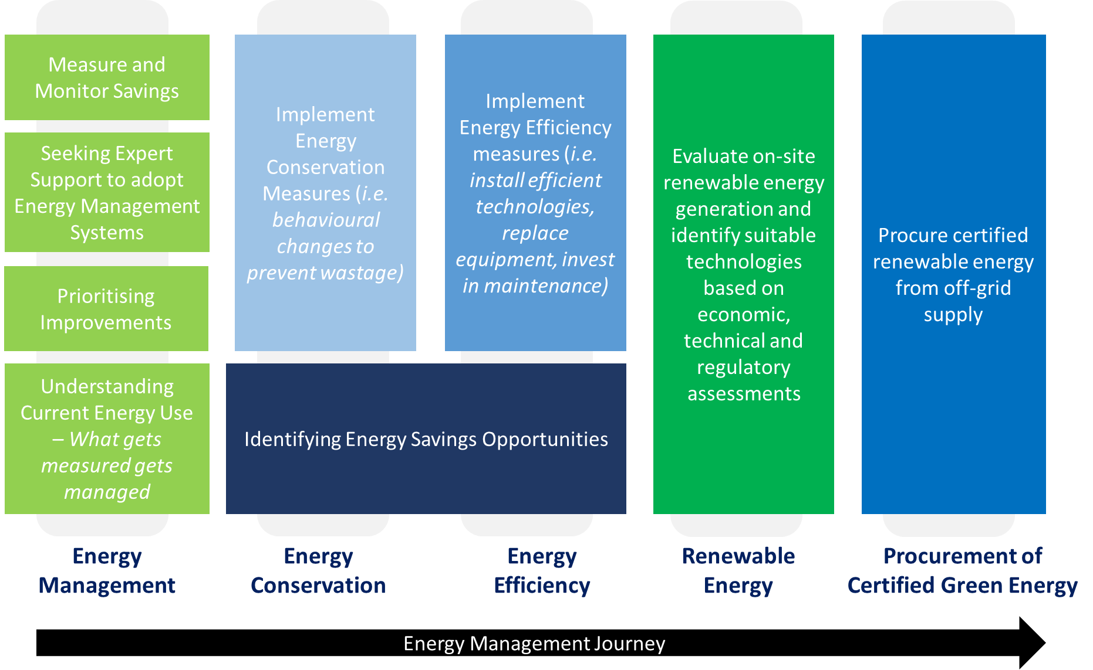
Approaches to Managing Energy Use

Slide 13
What is energy management?
Systematic, methodical, regular assessment of a business’ approach to energy management is essential to minimising energy wastage and maximising cost savings
COMPANY A
17%
0% = BAD PRACTICE 100% = BEST PRACTICE

Slide 14
ISO 50001 : 2018 – Energy management systems
Ensures continual improvement
Better control via a structured approach
Improved resource efficiency
Reduced costs
Reduced emissions of greenhouse gasses / carbon footprint
Helps ensure compliance with legislation
Improved organisational awareness
Enhanced reputation
Scoring increase in tenders, increase in volume of orders
Positive user experience: Over 9 out of 10 users strongly recommend ISO 50001
Plan
Do
Check
Act

Slide 15
What is Energy Efficiency (EE)?
Energy efficiency aims to gain the maximum results or effects from each unit of energy used. It is about achieving the same outcomes through less energy.
It reduces greenhouse gas emissions
It can enable >30% cost effective energy savings, across a range of engineering, production and building systems
It offers a cheaper, quicker and cleaner option compared to other emissions reduction solutions
It is low risk as the technologies are mature and proven
In addition to energy, cost and carbon savings, energy efficiency often leads to improved quality, increased production and enhanced comfort conditions
In the face of challenging macroeconomic conditions, now is the time to invest in energy efficiency in order to benefit from cost savings.

Slide 16
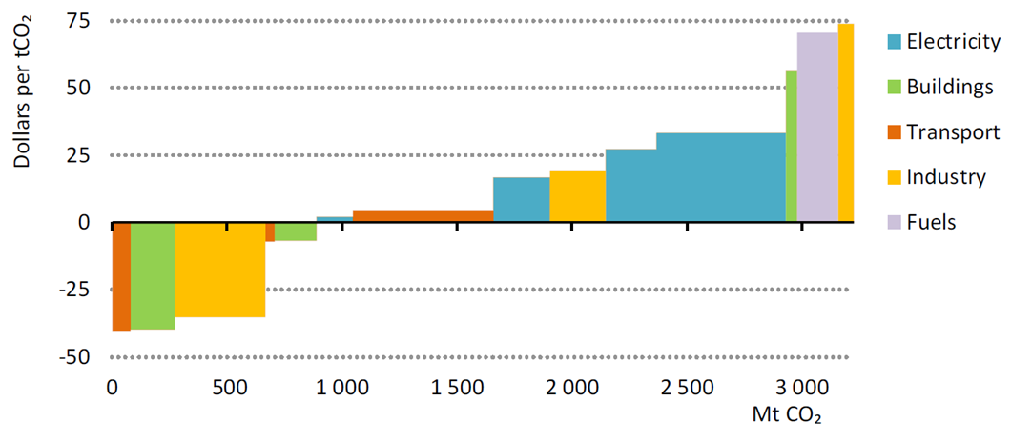
The business case for energy efficiency
Emissions avoided as a result of IEA’s Sustainable Recovery Plan
Energy efficiency measures deliver the largest overall reductions in emissions… Most of the interventions with negative abatement costs are efficiency measures
Source: International Energy Agency; Sustainable Recovery; June 2020

Slide 17
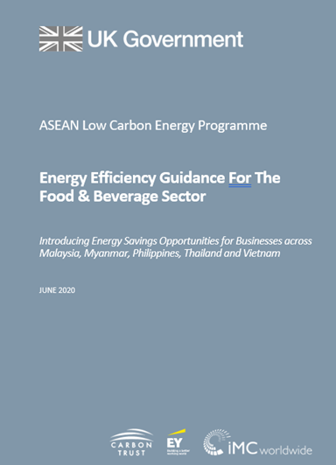
Sector Insights
Energy use in F&B Sector
COMMON PROCESSES
COMMON SYSTEMS
Food / feedstock reception and preparation
Materials handling and storage / Sorting, screening, grading, dehulling, destemming, destalking and trimming / Peeling / Washing / Thawing
Size reduction, mixing and forming
Cutting, slicing, chopping, mincing, pulping and pressing / Mixing, blending, homogenisation and conching / Grinding, milling and crushing / Forming/moulding and extruding
Separation techniques
Extraction / De-ionisation / Fining / Centrifugation and sedimentation / Filtration / Membrane separation / Crystallisation / Removal of free fatty acids by neutralisation / Bleaching / Deodorisation by stream stripping / Decolourisation / Distillation
Heat processing
Melting / Blanching / Cooking and boiling / Baking / Roasting / Frying / Tempering / Pasteurisation, sterilisation and UHT processing
Concentration by heat
Evaporation (liquid to liquid) / Drying (liquid to solid) / Dehydration (solid to solid)
Processing by removal of heat
Cooling, chilling and cold stabilisation / Freezing / Freeze-drying/lyophilisation
Post-processing operations
Packing and filling / Gas flushing and storage under gas
Utility processes
Cleaning and disinfection / Energy generation and consumption / Water treatment / Vacuum generation / Refrigeration / Compressed air generation
Product processing technology
Soaking / Dissolving / Solubilisation, alkalising / Fermentation / Coagulation / Germination / Brining, curing and pickling / Smoking / Hardening / Sulphitation / Carbonatation / Carbonation / Coating, spraying, enrobing, agglomeration, encapsulation / Ageing
Boilers & heat distribution
Motors & Drives
Compressed Air
MVAC
Lighting
Refrigeration
Cooking
Distillation, Drying & Evaporation
Process & Measurement Control

Slide 18
Market Insights
Status of Energy Efficiency in Myanmar
Energy Efficiency is a new concept for most companies
Energy Efficiency (EE) is a relatively new concept in Myanmar, especially among SMEs. Energy Management Systems are not typically in place and the narrative around benefits of EE to a company and to the country is still developing.
Tracking Energy Use is not widely adopted
Energy consumption is not something that is closely metered, monitored and reported – companies typically don’t maintain or analyse records of electricity use.
Energy Audits are rare for SMEs
Large food manufacturing companies are known to hire international energy auditors. Meanwhile, SMEs don’t usually engage energy auditors.
Low demand for ESCO services
Few Energy Service Companies (ESCOs) are active in Myanmar due to low demand for their offerings. Many companies are reluctant to invite external parties into their factories and facilities.

Slide 19
Market Insights
Energy Savings Potential in Myanmar’s F&B Sector
Food processing (particularly sugar and rice mills) requires high electrical and thermal demands. For sugar mills this is particularly focused on thermal energy, whilst for rice mills the main energy load is electrical. Many rice mills operate aged processing systems leading to quality losses of 15-20%, as well as quantity loss.
Examples of Energy Savings Potential in the Sugar and Rice sectors:
 | Energy Savings Potential (%) |  |  | Energy Efficiency Technologies
 | Minimum | Maximum | Average
Sugar Mills | 25% | 45% | 35% | EE Boilers, Waste Heat Recovery, Cogeneration, High Efficiency Motors
Rice Mills | - | 35% | - | Cogeneration, EE Boilers

Slide 20
Energy and Cost Savings Opportunities
Overview
Most businesses can achieve meaningful cost savings through reducing their energy consumption. Experience shows that even low and no-cost actions can usually reduce energy costs by at least 10% and produce quick returns, enhancing profitability.
  Operational Efficiency & Behavioural Change
  Low/no cost savings through measuring and monitoring energy use, staff engagement and appropriate improvements to the use and maintenance of existing equipment
  Industrial/Process Energy Efficiency
  Investment in new industrial technologies and processes including:
  Motors & drives
  Compressed air
  Process controls
  Refrigeration
  Process heating
  Building Energy Efficiency
  Investment in new building technologies including:
  Renewable Energy
  Investment in equipment to generate local renewable heat or electricity:
  Controls
  Lighting
  Heating
  Air conditioning
  Ventilation
  Sustainable biomass
  Heat pumps
  Wind
  Solar (thermal/PV)
  CHP
  Waste to energy

Slide 21
Energy and Cost Savings Opportunities
Optimising use | Boilers
Almost all of the sub-sectors in the food and beverage processing industry need some form of process heating for, for example, pasteurization, sterilization, blanching, peeling, evaporation, washing products and the cleaning of production halls and equipment. The required thermal energy is usually supplied by on-site boilers installed to supply hot water or steam at various temperatures and pressures depending on the process requirements.
Saving
Opportunity
10 – 30%+ | Of energy costs can commonly be reduced by ensuring efficient steam generation and distribution
10 – 15% | Of fuel can be saved from boiler and burner management systems, digital combustion controls and oxygen trim
10% | Of heat produced in steam boilers can be lost through insufficient or ineffective insulation on the distribution system and over 80% can be saved through application of cost effective insulation
5%+ | Of fuel used by steam boilers can be saved from the installation of full feedwater modulation control through reduced short cycling and improve efficiency
4 – 6% | Of energy can be saved by installing an economiser

Slide 22
Energy and Cost Savings Opportunities
Optimising Use| Motors & Drives
Electric motors drive the vast majority of processes used in the food and drink industry. However, they are often overlooked and as a result, many sites have relatively inefficient motor operations. Improving the efficiency of a plant’s motors can deliver significant energy and cost savings.
Saving
Opportunity
50% | Of electricity consumption can be reduced by slowing a motor’s speed by just 20% with a variable speed drive.
9% | Of energy consumption can be reduced by carrying out regular maintenance. This can include lubrication schedules, cleaning, belt tensioning and alignment checks.
20% | Is generally the proportion by which motors are oversized (the motor rating is larger than the actual rating required by the equipment). Energy savings can be achieved by replacing lightly loaded oversized motors with smaller, higher efficiency motors where cost effective.
5% | Of energy savings are possible if older failed motors are replaced with high efficiency models. Motors tend to be 1% to 2% less efficient when rewound.

Slide 23
Energy and Cost Savings Opportunities
Optimising Use| Chillers
The F&B industry is one of the largest users of refrigeration. For many businesses within the sector the provision of chilling and freezing services will account for >50% of electricity consumption and costs.
Saving
Opportunity
10% | Of energy savings can be achieved by increasing the condenser size by 30%. ~4 million kyat or more in costs for switching to a larger size condenser, with a payback period of less than 2 years.
9% | Of energy savings can be achieved from installing intelligent defrost controls which ensure that evaporators only defrost when necessary and maintain optimum temperature. For every 1°C increase in thermostat settings, energy savings of 2% are possible.
2 – 4% | Of compressor power can be reduced for every 1°C reduction in condensing temperature by introducing head pressure control with a low condensing temperature. The cost is nominal and payback period is almost immediate.
5% | Of energy savings can be achieved from cleaning a blocked condenser. ~180,000 kyat in cleaning costs and the payback is typically just a few weeks.

Slide 24
Steps to saving energy and costs in your business
There are many easy low and no-cost options to help save money and improve the operation of your F&B business. Companies can start with the following steps:
1.
Understand your energy use
Look at your operations and identify the major areas of energy consumption. Check the condition and operation of equipment and monitor the power consumption over say, one week to obtain a base figure against which energy efficiency improvements can be measured.
3.
Prioritise your actions
Draw up an action plan detailing a schedule of improvements that need to be made and when, along with who will be responsible for them.
5.
Make the changes and measure the savings
Implement your energy saving actions and measure against original consumption figures. This will assist
future management decisions regarding your energy priorities.
2.
Identify your opportunities
Compile an energy checklist. Walk round your building and complete the checklist at different times of day (including after hours) to identify where energy savings can be made.
4.
Seek specialist help
It may be possible to implement some energy saving measures in-house but others may require specialist assistance. Discuss the more complex or expensive options with a qualified technician.
6.
Continue to manage your
Business for energy efficiency
Enforce policies, systems and procedures to ensure that your business operates efficiently and that savings are maintained in the future.

Slide 25
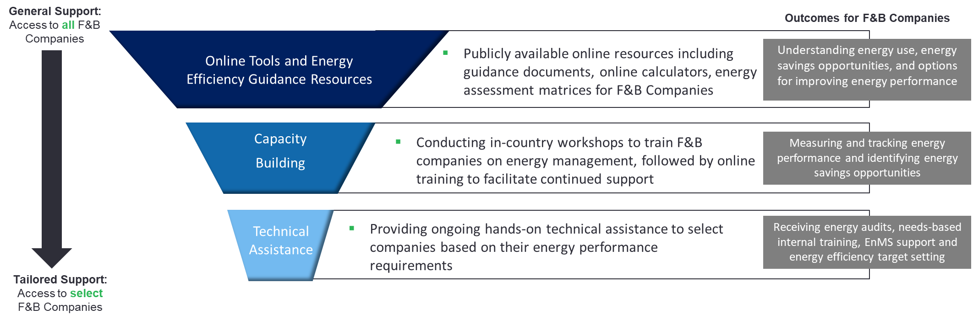
How can the ASEAN Low Carbon Energy Programme (LCEP) support you?
LCEP can help F&B companies identify energy savings opportunities and take steps to set up new energy management systems or improve existing systems. The following support will continue until March 2022 and will be offered to F&B companies at no cost:

Slide 26
Benefits of Participating in LCEP
The programme support will be open to Small, Medium and Large sized companies, primarily involved in processing and manufacturing of food and beverages, with operations in Malaysia, Myanmar, Philippines, Thailand or Vietnam. The targeted participants of the programme include sustainability professionals, energy managers and senior management who will benefit from a hands-on understanding of how to improve the energy performance of their company operations.
Companies should participate because:
They will have access to free resources and technical support provided by international practitioners and local experts experienced in delivering and implementing energy savings projects in energy-intensive sectors including food and beverage.
They will be able to understand the energy use, energy savings opportunities and the “no-cost and low-cost” measures available for improving energy performance, and thereby experience cost savings.
They will be able to measure and track energy performance over time, and report on their progress leading to reputational benefits.
They will be equipped to deal with emerging energy and emissions related policies in the region and maintain their competitive edge in dealing with international trends.
They may find it easier to access export markets that value sustainability and low carbon business models.

Slide 27
Questions?

Slide 28
Get in Touch
If your company is interested in receiving LCEP support, or if you have any questions regarding webinar, then please reach out to:
Carbon Trust Singapore: Singapore@carbontrust.com
Whilst reasonable steps have been taken to ensure that the information contained within this publication is correct, the authors, the Carbon Trust, its agents, contractors and sub-contractors give no warranty and make no representation as to its accuracy and accept no liability for any errors or omissions. All trademarks, service marks and logos in this publication, and copyright in it, are the property of the Carbon Trust (or its licensors). Nothing in this publication shall be construed as granting any licence or right to use or reproduce any of the trademarks, services marks, logos, copyright or any proprietary information in any way without the Carbon Trust’s prior written permission. The Carbon Trust enforces infringements of its intellectual property rights to the full extent permitted by law.
The Carbon Trust is a company limited by guarantee and registered in England and Wales under company number 4190230 with its registered office at 4th Floor Dorset House, Stamford Street, London SE1 9NT.
Published in the UK: 2020.
© The Carbon Trust 2020. All rights reserved.

