Slide 1
Energy Catalyst Round 8 – Competition Briefing
Alice Goodbrook
Innovation Lead – Energy Catalyst

Slide 2


Innovate UK
We are the UK’s innovation agency
We invest in new ideas and technologies and connect businesses to the right people, to drive economic growth and social benefits
Notes:
Innovate UK is the UK’s government innovation agency
We are here to help bring early stage, risky innovation to market as quickly as possible
We do this by providing funding in the forms of grants as well as connecting business to partners, investors and first customer (fund and connect)

Slide 3
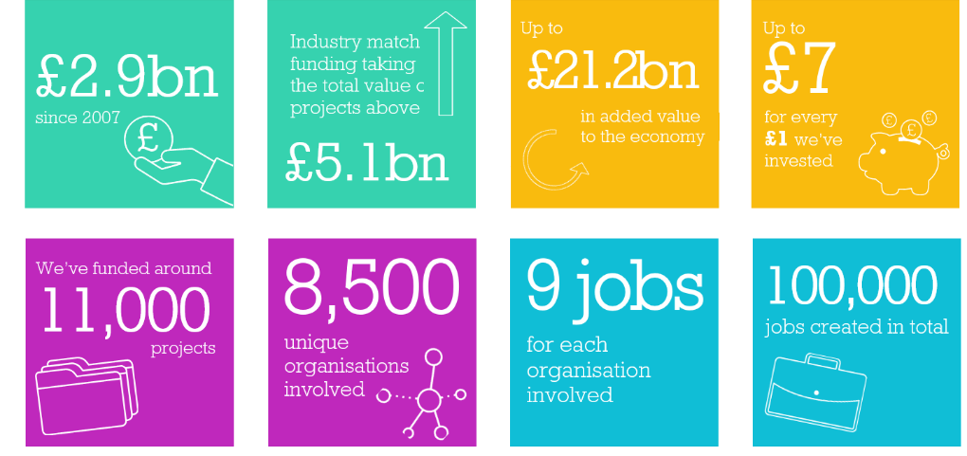
Since 2007 we have delivered…
Notes:
We started in 2007 and since then we have invested more than £3bn and are ramping up to spending more than £1bn a year
While most of our programmes aim to look at creating innovation to stimulate UK economic growth, we run a few international programmes through the UK Aid budget which primarily look at creating economic prosperity in emerging economies.
Energy Catalyst is now one of these programmes

Slide 4




Challenges of Energy Poverty
Over 1 billion people do not have access to electricity
The Energy Catalyst’s mission is to accelerate the innovation needed to end energy poverty. By providing financial and advisory support to innovators we help create strategic partnerships, uncover insights and develop business models to improve lives in Africa and Asia.
Over 3 billion people rely on solid fuels and kerosene for cooking and heating
Grid based systems face economic and governance barriers
Vast majority (80%) of those gaining access to electricity worldwide are in urban areas
Over 1 billion people do not have access to electricity
Over 3 billion people rely on solid fuels and kerosene for cooking and heating
Energy is a key factor in sustainable development and poverty alleviation
Sustainable Development Goal 7: ensure access to affordable, reliable, sustainable and modern energy for all
Vast majority (80%) of those gaining access to electricity worldwide are in urban areas
Notes:
Key slide

Slide 5





Energy Catalyst Programme
1.
Collaboration building
2.
Funding competition
3.
Accelerator
4.
Follow-on support
5.
Learnings from across energy access sector
Forming partnerships
Developing technology
Commercial development
Preparing for next steps
Facilitating international knowledge sharing from the industry
Notes:
Key slide

Slide 6







Energy Catalyst Competition
7 Calls
£140m Committed
£60m
Co-funding
£75m Private
funding
345
Projects
1040
Partners
113
International
partners

Slide 7
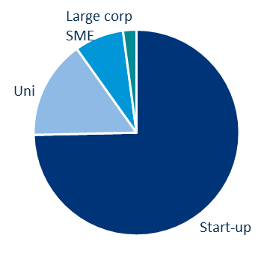
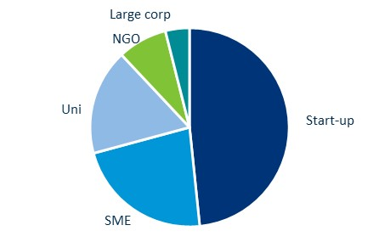
Energy Catalyst Round 7 Portfolio
Start-ups lead 75% of the project.
~50% of all project participants are start-ups.
Early stage projects are just over half the cohort
PROJECT LEADS
PROJECT MEMBERS
PROJECT STAGES
Late
Mid
Early
(on average 3.6 partners/project)

Slide 8
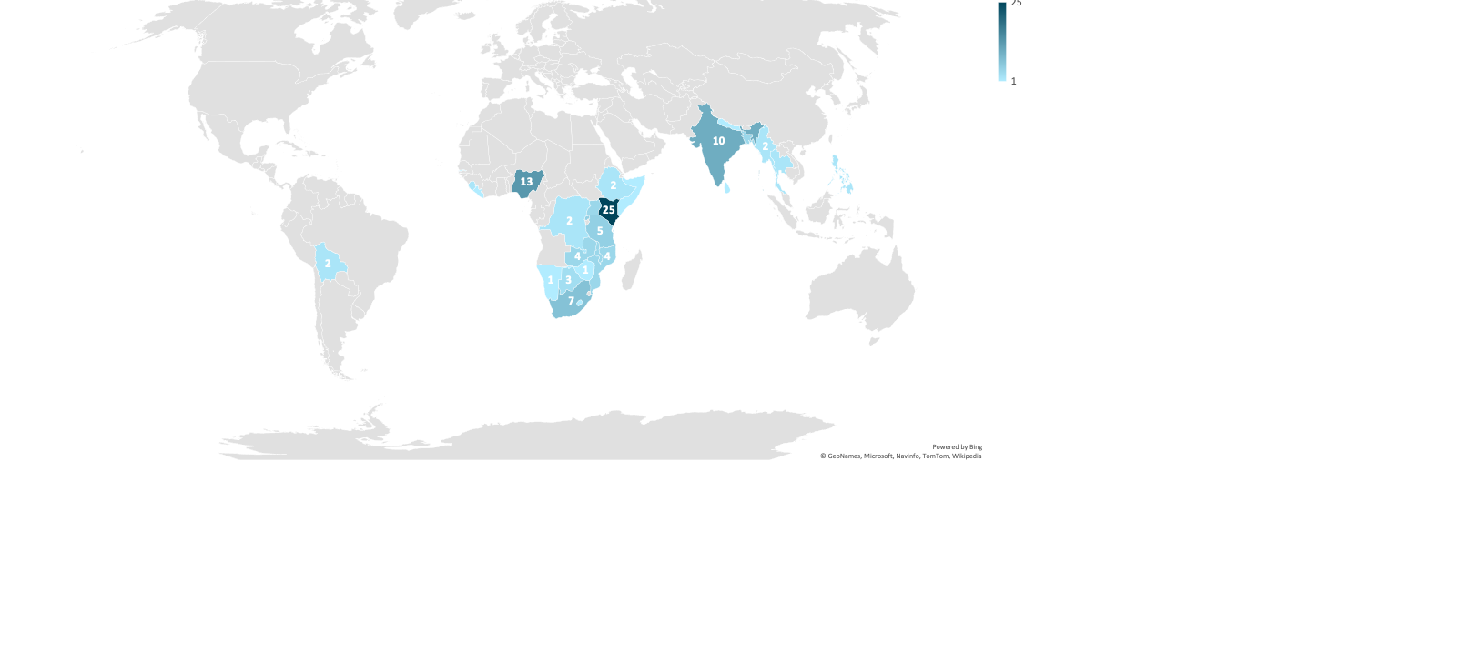
Energy Catalyst Round 3 to 7 – Project focus countries
Missing from this map are:
> 28 crosscutting country focused projects
> 7 early stage projects in Rounds 3 and 4 developed innovations for the UK market.
Notes:
This map shows where projects applying to Energy Catalyst have focus. As the note states, there is over 50 projects which are not represented on the map in order to not mis-represent the data. These are projects, typically early stage, are working to refine their target country/region or have applied to considering multiple countries / regions.
Also not represented on this graph is 2 projects which have been funded under previous rounds in Bolivia.

Slide 9
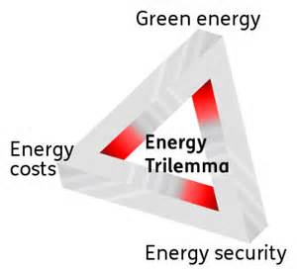


Overview Energy Catalyst Round 8
To be in scope your project must address the following:
Total amount of funding available up to
£20m
3
Strands
which you can apply into
Energy
Trilemma
Transforming
Energy Access
Gender equality and social inclusion
Early
Mid
Late
Notes:
Key slide

Slide 10

Eligible Focus Countries
Your project must target one or more of the following countries.
Sub-Saharan Africa:
Angola, Benin, Botswana, Burkina Faso, Burundi, Cabo Verde, Cameroon, Central African Republic, Chad, Comoros, Congo, Côte d'Ivoire, Democratic Republic of the Congo, Djibouti, Eritrea, Eswatini (Swaziland), Ethiopia, Equatorial Guinea, Gabon, Gambia, Ghana, Guinea, Guinea-Bissau, Kenya, Lesotho, Liberia, Madagascar, Malawi, Mali, Mauritania, Mozambique, Namibia, Niger, Nigeria, Rwanda, Sao Tome and Principe, Senegal, Sierra Leone, Somalia, South Africa, South Sudan, Sudan, Tanzania, Togo, Uganda, Zambia, Zimbabwe
South and South East Asia:
Afghanistan, Bangladesh, Bhutan, Cambodia, India, Indonesia, Laos, Malaysia, Myanmar, Nepal, Pakistan, Philippines, Sri Lanka, Thailand, Vietnam

Slide 11


Funding Sources
Department for International Development (DFID)
Started co-funding in Round 3 (2015)
Co-funded a total of £34m to date, including up to £5m available for Round 8
Provided funds to primarily energy storage projects
Provides funding towards Energy Catalyst Accelerator
Global Challenges Research Fund (GCRF)
Started co-funding in Round 7 (2019)
Invested £44.9m of funding to date, including up to £15m available for Round 8
No technology specific priorities
Addition funding towards collaboration building, Energy Catalyst Accelerator, and post competition

Slide 12
DFID Round 8 Funding
£5 million of funding in this competition
Up to £3 million will be prioritised for projects specifically for energy storage.
DFID is also particularly interested in supporting projects in the areas of:
  Modern cooking
  Sustainable cooling
  Next generation solar
  Efficient and productive appliances
  Technologies and business models which help leave no-one behind
A list of DFID priority countries is provided in the competition brief
Note: DFID will also consider outstanding projects in other areas and geographies.

Slide 13
Eligibility Overview
Stream of competition | Early Stage Project |  | Mid Stage Project | Late Stage Project
Type of project | Feasibility Studies |  | Industrial Research | Experimental Development
Total eligible project costs | £50,000 - £300,000 |  | £50,000 - £1.5 million | £50,000 - £5 million
Total project duration | 6 – 12 month |  | 12 to 24 months | 12 to 36 months.
Collaborations | UK SME can apply on their own (otherwise collaborative) |  | Must be collaborative | Must be collaborative
Project lead | Must be led by a SME, academic or RTO |  | Must be led by a business | Must be led by a business
International requirement | Work in-country encouraged but not required |  | Some work (testing/demonstration) must be done in SSA, SA or SEA. | Some work (testing/demonstration) must be done in SSA, SA or SEA.
International partners | International partners encouraged |  | Partner with international entity in country required | Partner with international entity in country required
Research | Max 50% research participation |  | Max 30% research participation | Max 30% research participation

Slide 14
How to apply
Full competition and application details are available on the Innovation Funding Service (IFS).
You will be asked to complete 15 questions as part of your application:
  Project details: Project summary, description, Administrative & Technical leads, Technology sector and countries of focus
  Question 1–3 are pass/fail gateway questions:
    Official Development Assistance (ODA); Energy Trilemma; Gender Equality & Social Inclusion
  Question 4 - Equality, diversity and inclusion (not scored)
  Questions 5 –15 are scored application questions.
Applications which do not pass the gateway questions will be immediately rejected and not sent for assessment.

Slide 15


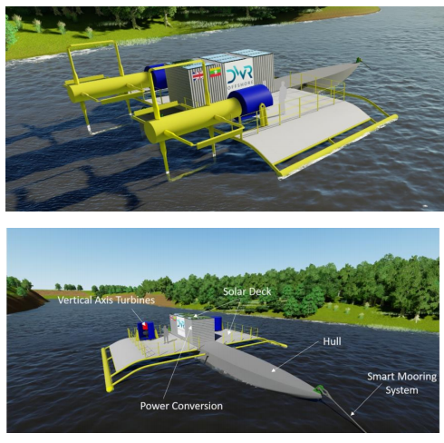
Example: Floating Instream and Solar (FITS) Power Plant
DWR is developing a Floating Instream Tidal and Solar (FITS) Power Plant
Incorporates two vertical axis turbines and Solar Photovoltaic (PV) panels and has an innovative modular design which can deliver 200kWp rated capacity to the end user.
The Power Plant has been designed for low-speed and high-speed river flows and is currently at a mid-stage development phase. This project will support the development and fabrication of a full-scale demonstrator and shall be tested at a river site location in Myanmar.
Predictable and consistent energy output and can contribute to the baseload power requirements of energy off-takers.
The design of the Power Plant focuses on composite materials for the blades and lean optimised fabrication processes. This makes it simple and cheap to produce.

Slide 16
Questions?
alice.goodbrook@innovateuk.ukri.org

